Slide 1

Combining SLAM and NeRF
Project Phase I (ECD401)
Mid Semester Examination -2 (November 9, 2022 , Wednesday)
PROJECT TEAM MEMBERS NAME OF SUPERVISOR
1. BIPASHA PARUI (BT19ECE019) DR. K SURENDER
2. YAGNESH DEVADA (BT19ECE122)

Slide 2

Contents
Work Done till Midsem-Evaluation 1
Dataset preparation and camera calibration
Visual Odometry implementation of dataset
SLAM implementation on custom dataset
Feature extraction and 3D mapping using SLAM framework

Slide 3
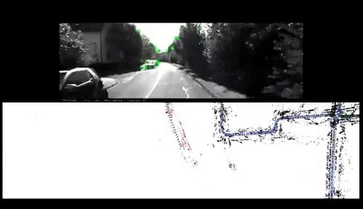
Work Done in last evaluation
We had formulated the problem statement and done some literature review for methods of SLAM and NeRF in mapping problems.
Implemented base papers* of LSD slam on KITTI dataset for visual odometry and mapping.
* Visual Odometry Part I: The First 30 Years and Fundamentals Scaramuzza et al. IEEE ROBOTICS & AUTOMATION MAGAZINE
Visual Odometry Part II: Matching, Robustness, Optimization, and Applications Scaramuzza et al. IEEE ROBOTICS & AUTOMATION MAGAZINE
Notes:
Deals with localizing the agent in the environment and simultaneously building the map of the environment. Since localization and mapping is done simultaneously, both the modules are dependent on each other.

Slide 4
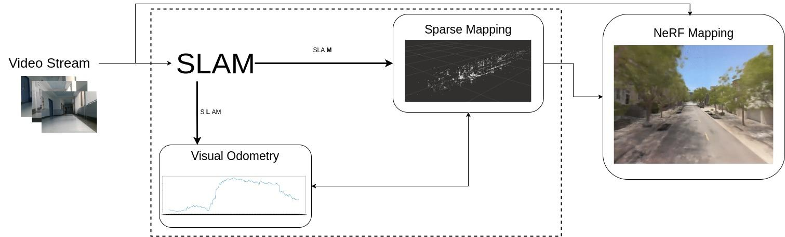
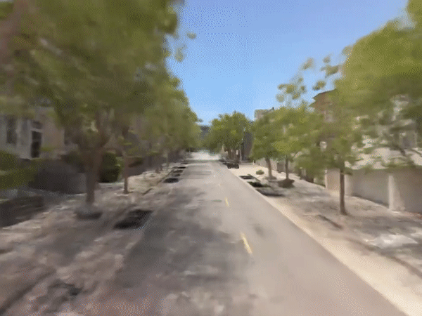
Flowchart

Slide 5
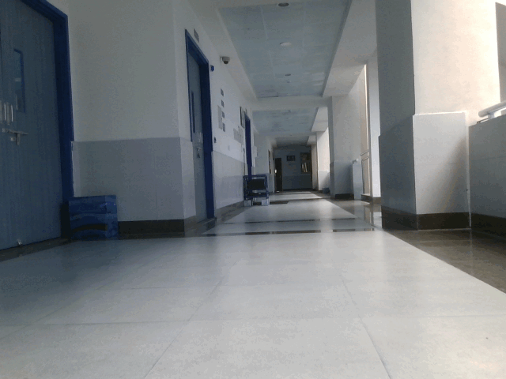
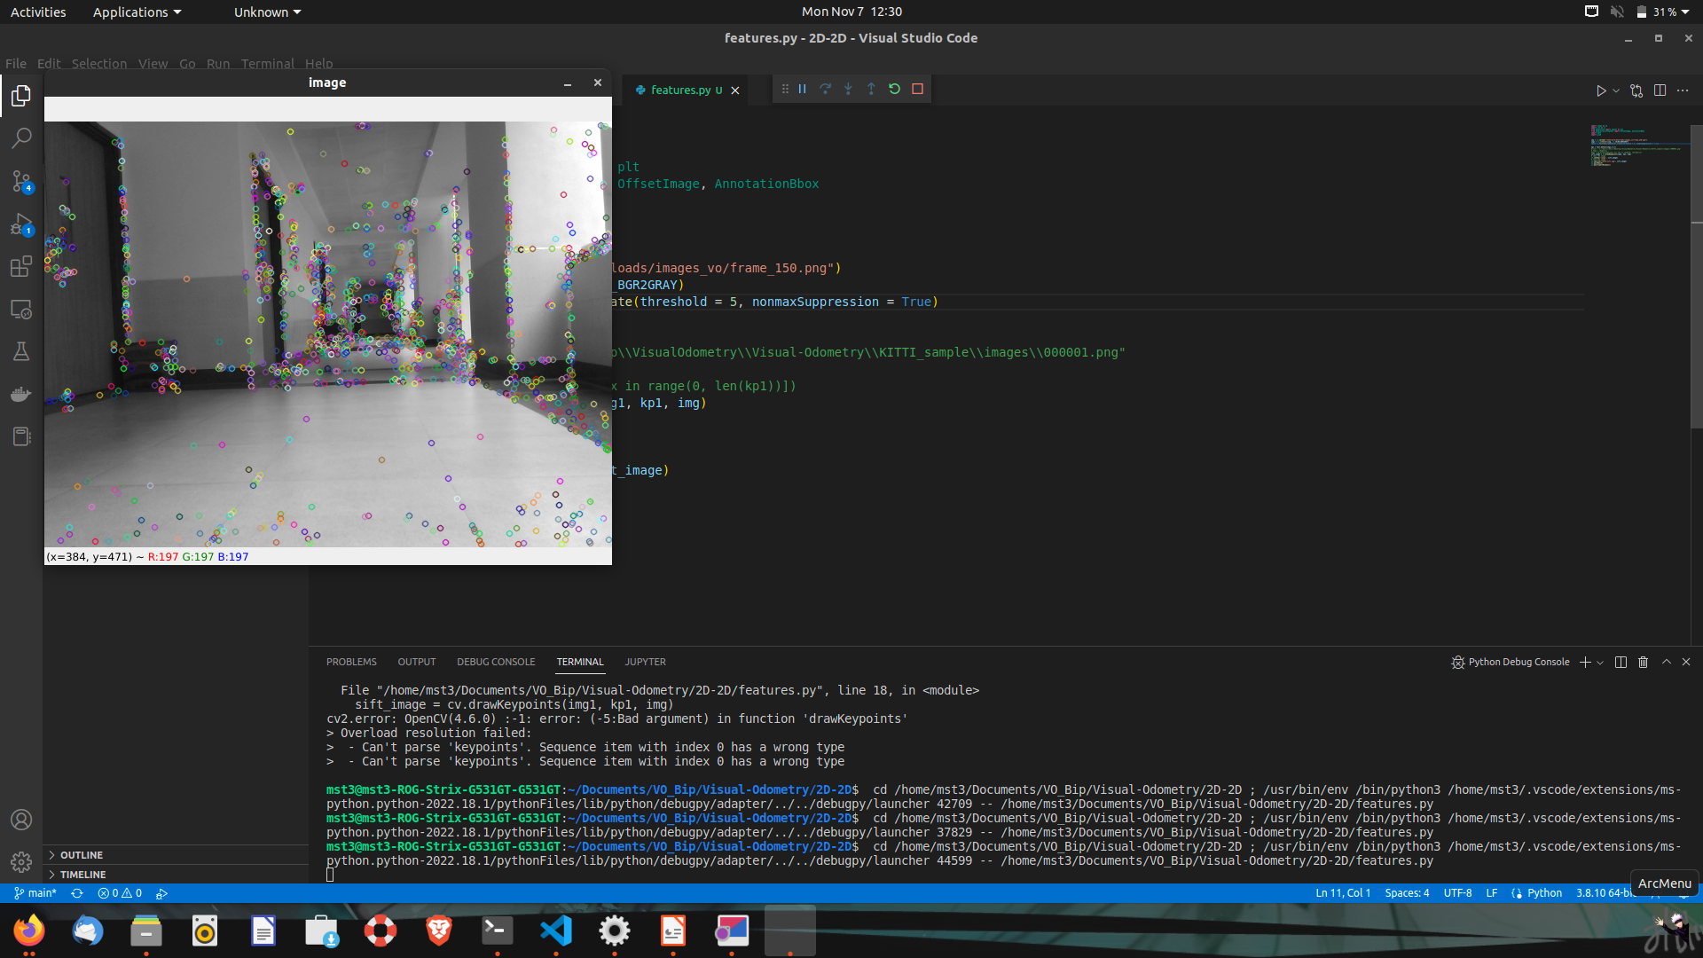
Dataset Generation
Current evaluation and training is being done on a mini dataset generated in the VNIT’s New Academic building.
The video was recorded using a RealSense D415 RGB-D camera. The feature extractions were done using ORB features which show similar efficiency in terms of scale and illuminance variance as SIFT but comparatively faster are more selective.

Slide 6
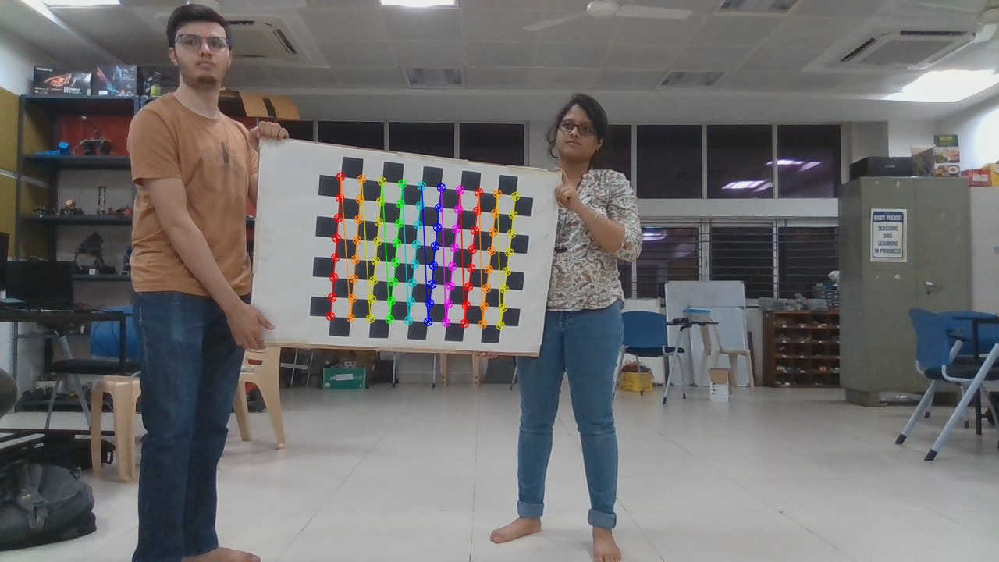
Calibration
In order to perform slam on generated dataset, the camera was first calibrated using Zhang’s method or checkerboard method. It makes use of the coplanarity constraint of corner points in checkerboard to extract the intrinsic parameters of the camera.
Obtained Calibration values
[[924.72,0 ,616.02], _[0 ,924.39,360.19],
[0 ,0 ,1 ]]

Slide 7
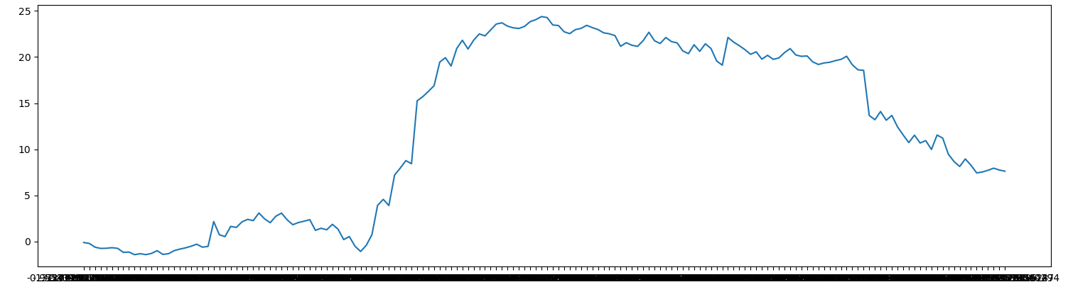
Visual Odometry and 3D mapping
We have implemented visual odometry, ORB slam and RTAB mapping to get the 3D point cloud and trajectory of the building as observed from the dataset.
The following shows the trajectory obtained from visual odometry pipeline of the tnp department lobby.
Trajectory of the robot (Top View)
Translation in vertical direction (Sideway Movement)
Translation in horizontal direction ( Frontal movement)

Slide 8
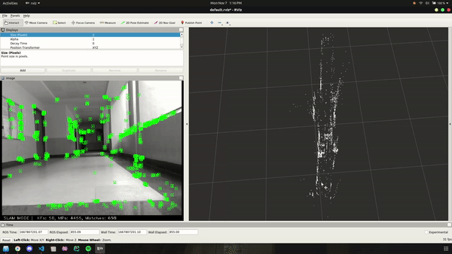
Results
Results from SLAM pipeline
Feature extraction in live frames
Generated point cloud

Slide 9
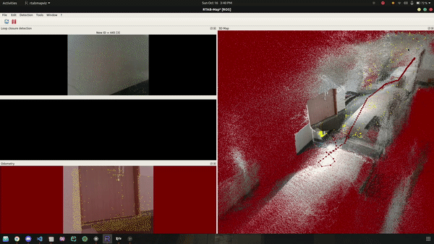
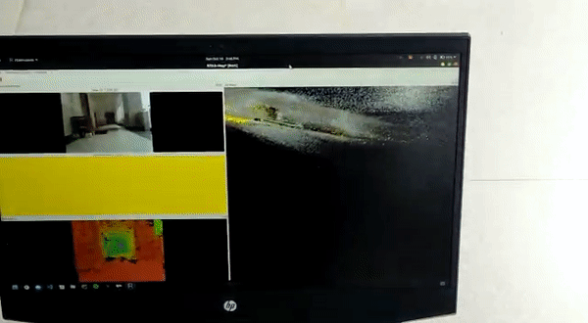
Results
RTAB Mapping - Near TnP department

Slide 10
Timeline for the Project Completion
Literature Review
Aug 22
Generating a local map from our own dataset.
Oct 22
Local and global map fusion with NeRF module
Jan 22
Adding backend optimizations
March 22
SLAM with NeRF integration
Sept 22
Understanding the code base.
Nov, Dec 22
Optimizing the local map
Feb 22
Optimizing the localization module to further improve NeRF based mapping

Slide 11
Work to be Done by the Next Evaluation
Refining generated point cloud with dense points and RGB information
Implementing NeRF i.e generating novel 3D views on our dataset.
Fusion phase-1 results i.e 3D point cloud of scene generated from v-slam with NeRF based inpainting to refine sparse map into dense 3D map.

Slide 12
Conclusion
SLAM deals with finding the position of an agent in the environment along with building the map of the same environment. A better estimate of the agent’s position leads to accurate map of the environment and vice versa.
NeRF based mapping allows us to generate novel view of the object through a simple neural network.
Merging both of them would improve mapping aspect of SLAM and thus enable better localization of the agent.

Slide 13
References
SLAM (Simultaneous Localization and Mapping) [Blog]
What is Visual SLAM Technology and What is it Used For? [Blog]
ORB-SLAM: a Versatile and Accurate Monocular SLAM System Raul et al. IEEE Transactions on Robotics 2015
NeRF: Representing Scenes as Neural Radiance Fields for View Synthesis, Ben, CVPR 2020
Point-NeRF: Point-based Neural Radiance Fields Qiangeng et al. CVPR 2022
Inpainting and volumetric synthesis from sparse point cloud.
Depth-supervised NeRF: Fewer Views and Faster Training for Free Kangle et al. CVPR 2022
Sparse Point cloud aided approach to improve the training time with fewer views.

Slide 14
Thank You

Slide 15
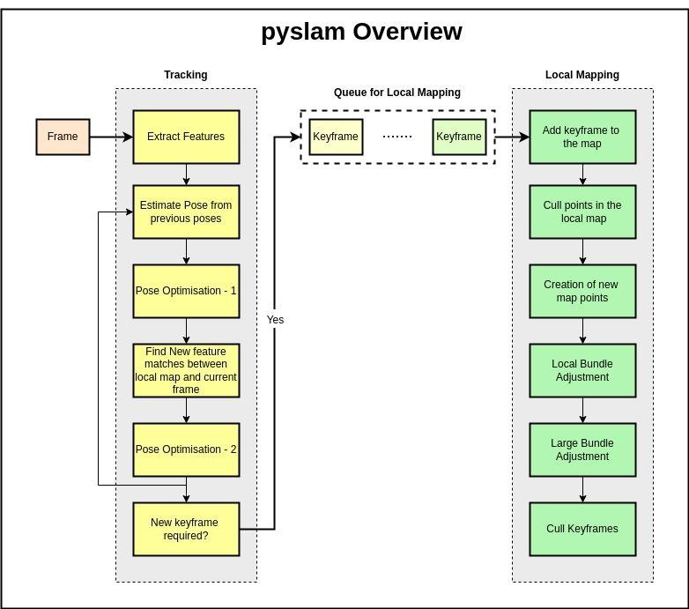

Slide 16


Slide 18
